Slide 1
Internetworking Devices
Repeater, Hub, Bridge, switch, router, gateway

Slide 2
Networking Devices
Equipment that connects directly to a network segment is referred to as a device.
These devices are broken up into two classifications.
-End-user devices
-Network devices
End-user devices include computers, printers, scanners, and other devices that provide services directly to the user.
Network devices include all the devices that connect the end-user devices together to allow them to communicate.

Slide 3
Collision domains and Broadcast domains
Is a network segment with two or more devices sharing the same BW.
The definition of a collision domain is a set of LAN devices whose frames could collide with one another.
This happens with hubs, bridges, repeaters and wireless access points as only one device can send and receive.
If more than one device tries sending or receiving, the information is lost and irrecoverable it will need to be resent.
This can slow down network performance along with making it a security threat.

Slide 4
Collision domain
A hub is considered a layer one device of the OSI Model; all it does is send frames out on all ports including the port in which the frame was received on.
This causes a collision domain because only one device can send at the same time. This also shares the bandwidth between of all devices connected to that collision domain.
These devices can inefficiently use that bandwidth because of the CSMA/CD and jamming signals

Slide 5
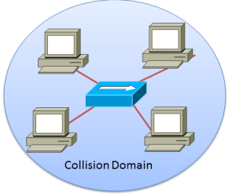
Collision Domain

Slide 6
Collision domain -Switch
A switch uses layer two of the OSI model, so the switch uses MAC Address to send frames to the correct device.
Rather than sending it to all ports a switch only sends the frame out one port, if it has the MAC address in its MAC address table.
If not the switch will send the frame on all ports except for the port in which the frame was received on.

Slide 7
Collision domain -Switch
Switches provide separate collision domains on each port, this provides dedicated bandwidth to that device and allows simultaneous conversations between devices on different ports.
Each port can be operated at full-duplex so the device can send and receive information at the same .

Slide 8
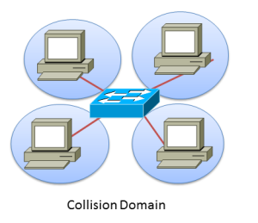
Collision domain -Switch

Slide 9
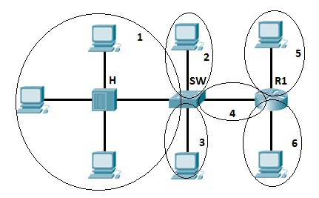
Collision Domain

Slide 10
Broadcast domain
A broadcast domain is a domain in which a broadcast is forwarded.
Every one LAN will be recognized as on one broadcast domain.
A broadcast domain contains all devices that can reach each other at the data link layer (OSI layer 2) by using broadcast.
All ports on a hub or a switch are by default in the same broadcast domain.
All ports on a router are in the different broadcast domains and routers don’t forward broadcasts from one broadcast domain to another.

Slide 11
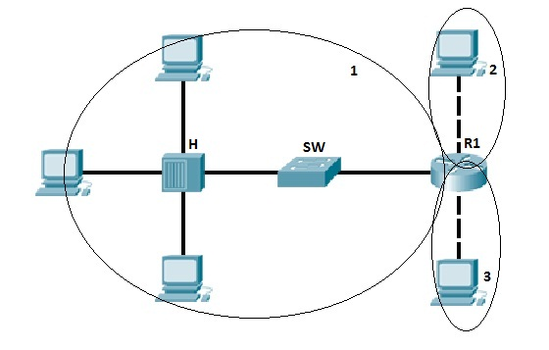
Broadcast Domain

Slide 12
NOTE
Each port on a hub is in the same collision domain. Each port on a bridge, a switch or router is in a separate collision domain
All ports on a hub or a switch are in the same broadcast domain, and all ports on a router are in a different broadcast domain.

Slide 13
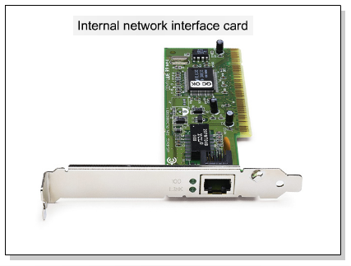
Network Interface Card
A network interface card (NIC) is a printed circuit board that provides network communication capabilities to and from a personal computer. Also called a LAN adapter.

Slide 14
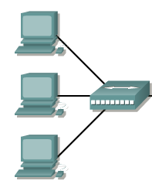
Hub
Connects a group of Hosts

Slide 15
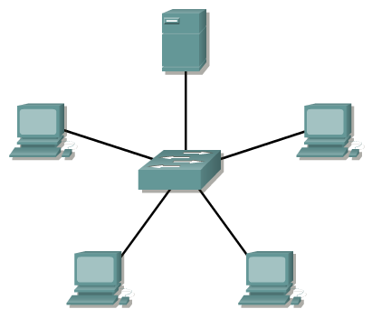
Switch
Switches add more intelligence to data transfer management.

Slide 16

Router
Routers are used to connect networks together
Route packets of data from one network to another
Cisco became the de facto standard of routers because of their high-quality router products
Routers, by default, break up a broadcast domain

Slide 17
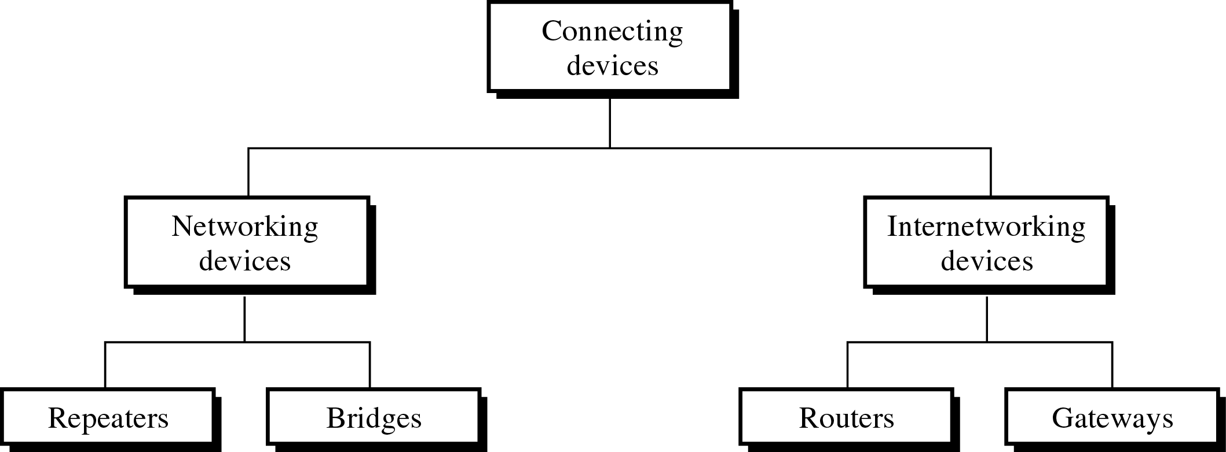
Connecting Devices

Slide 18
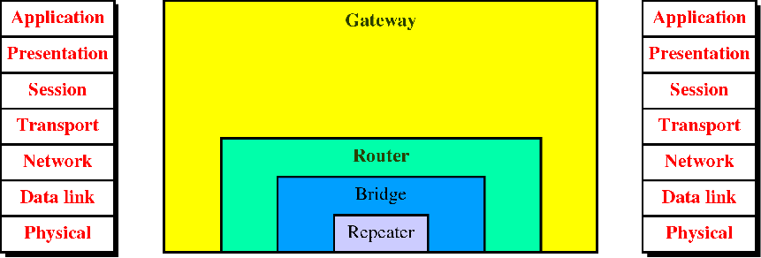
Classification of connecting devices
HUB
Passive Hub

Slide 19
Classification
Passive hub: operate below the physical layer
Repeater/ active hub: operate at the physical layer
Bridge (or two layer switch): operate at the physical and data link layer
Router (or three layer switch): operate at physical, data link layer and network layer .
Gateway: can operate all the layers

Slide 20
Purpose
First, they allow a greater number of nodes to be connected to the network.
Second, they extend the distance over which a network can extend.
Third, they localize traffic on the network.
Fourth, they can merge existing networks.
Fifth, they isolate network problems so that they can be diagnosed more easily.

Slide 21
Passive hub
A passive hub is just a connector
A passive hub is a central connecting device in a network that acts as a point contact for wires from numerous stations in a star topology.
It does not provide any regeneration or processing of signals.

Slide 22
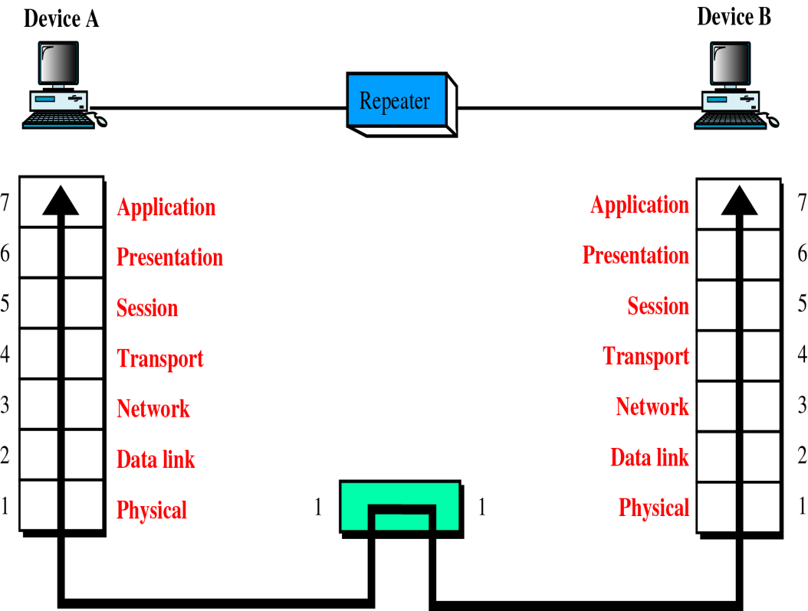
Repeater in the OSI model

Slide 23
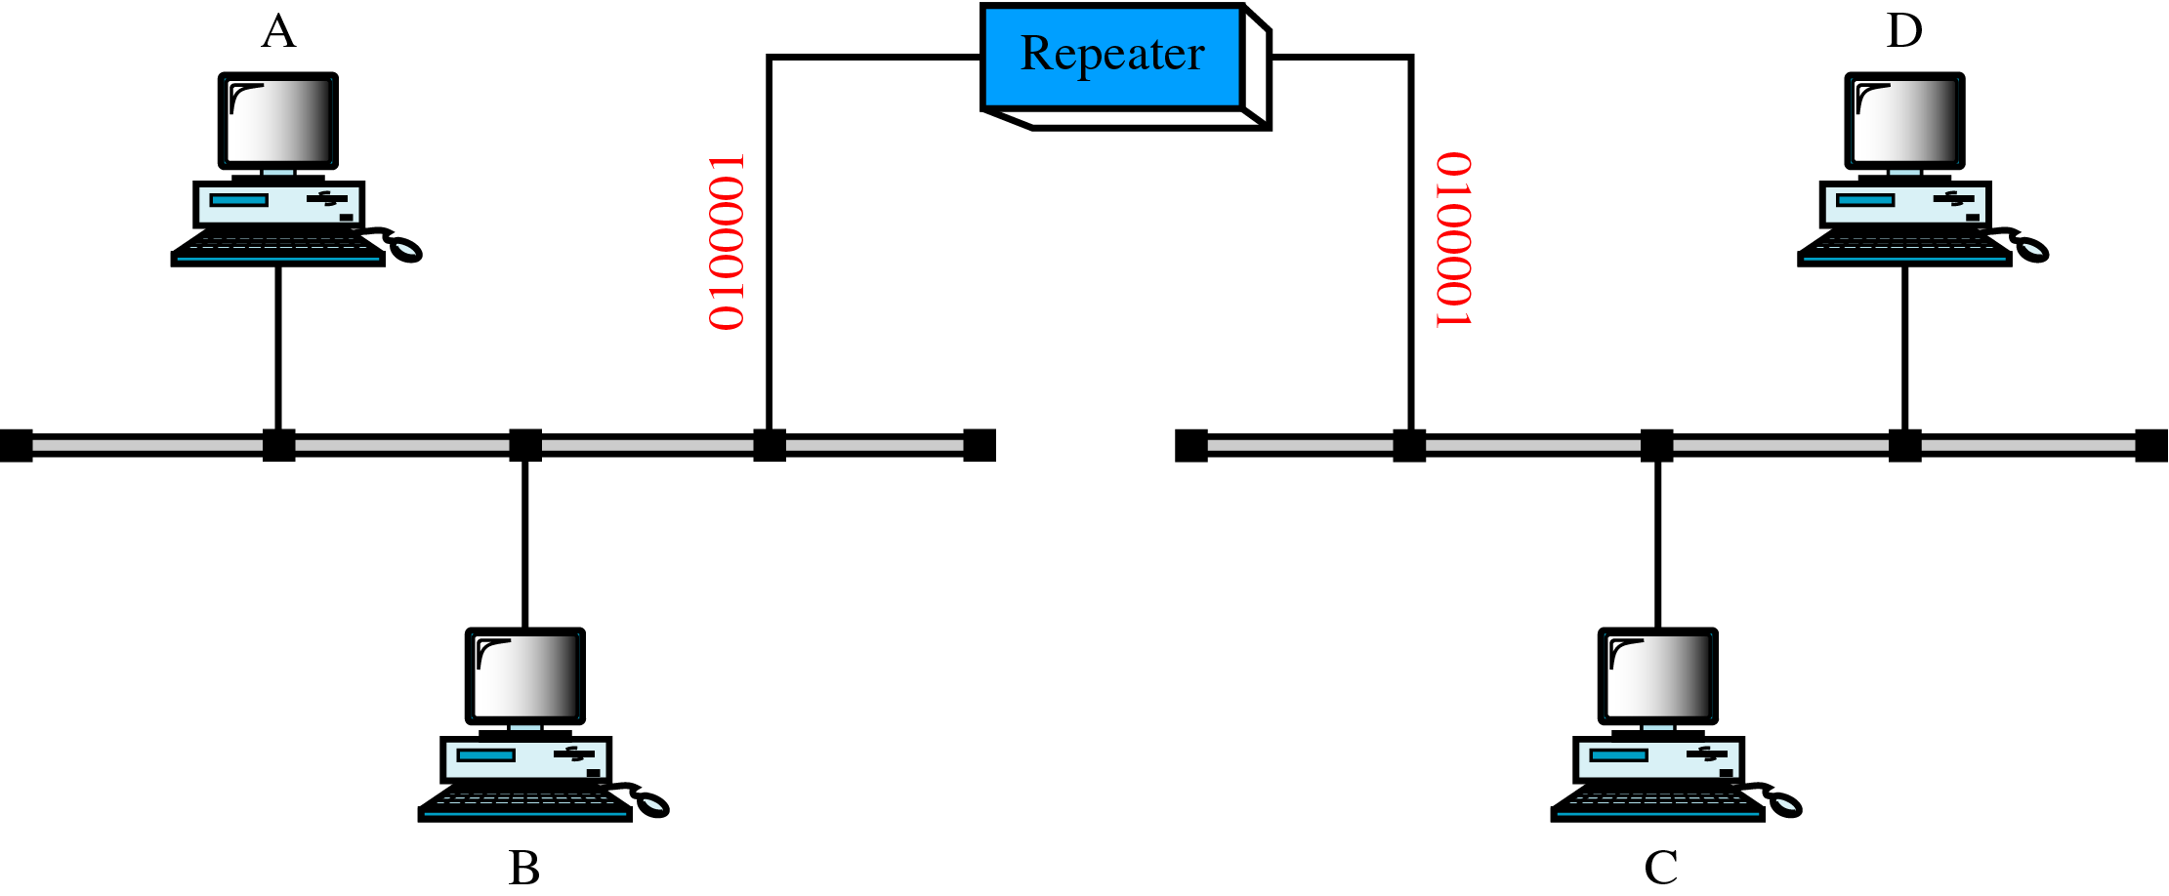
A repeater

Slide 24
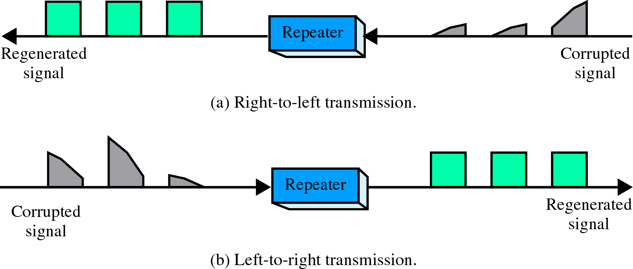
Function of a repeater

Slide 25
Repeater
Device that operates only in the physical layer
During signal transmission, signal may attenuate and the integrity of data is changed.
A repeater receives a signal and, before it becomes too weak or corrupted, regenerates the original bit pattern.
The repeater then sends the refreshed signal.
A repeater can extend the physical length of a LAN
A repeater does not actually connect two LANs; it connects two segments of the same LAN.
The segments connected are still part of one single LAN.
A repeater is not a device that can connect two LANs of different protocols.
The location of a repeater on a link is vital.
A repeater must be placed so that a signal reaches it before any noise changes the meaning of any of its bits.

Slide 26
Repeater
A repeater can overcome the 10Base5 Ethernet length restriction. In this standard, the length of the cable is limited to 500 m.
To extend this length, we divide the cable into segments and install repeaters between segments.
Note that the whole network is still considered one LAN, but the portions of the network separated by repeaters are called segments.
The repeater acts as a two-port node, but operates only in the physical layer.
When it receives a frame from any of the ports, it regenerates and forwards it to the other port.

Slide 27
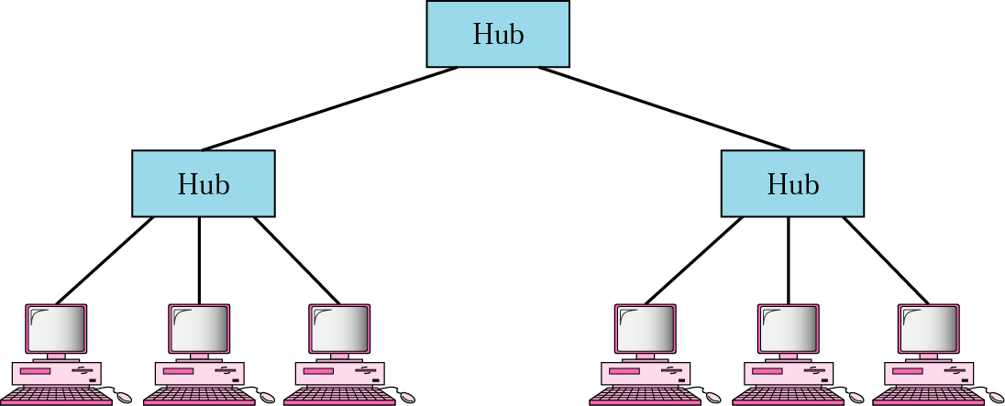
Active Hub

Slide 28
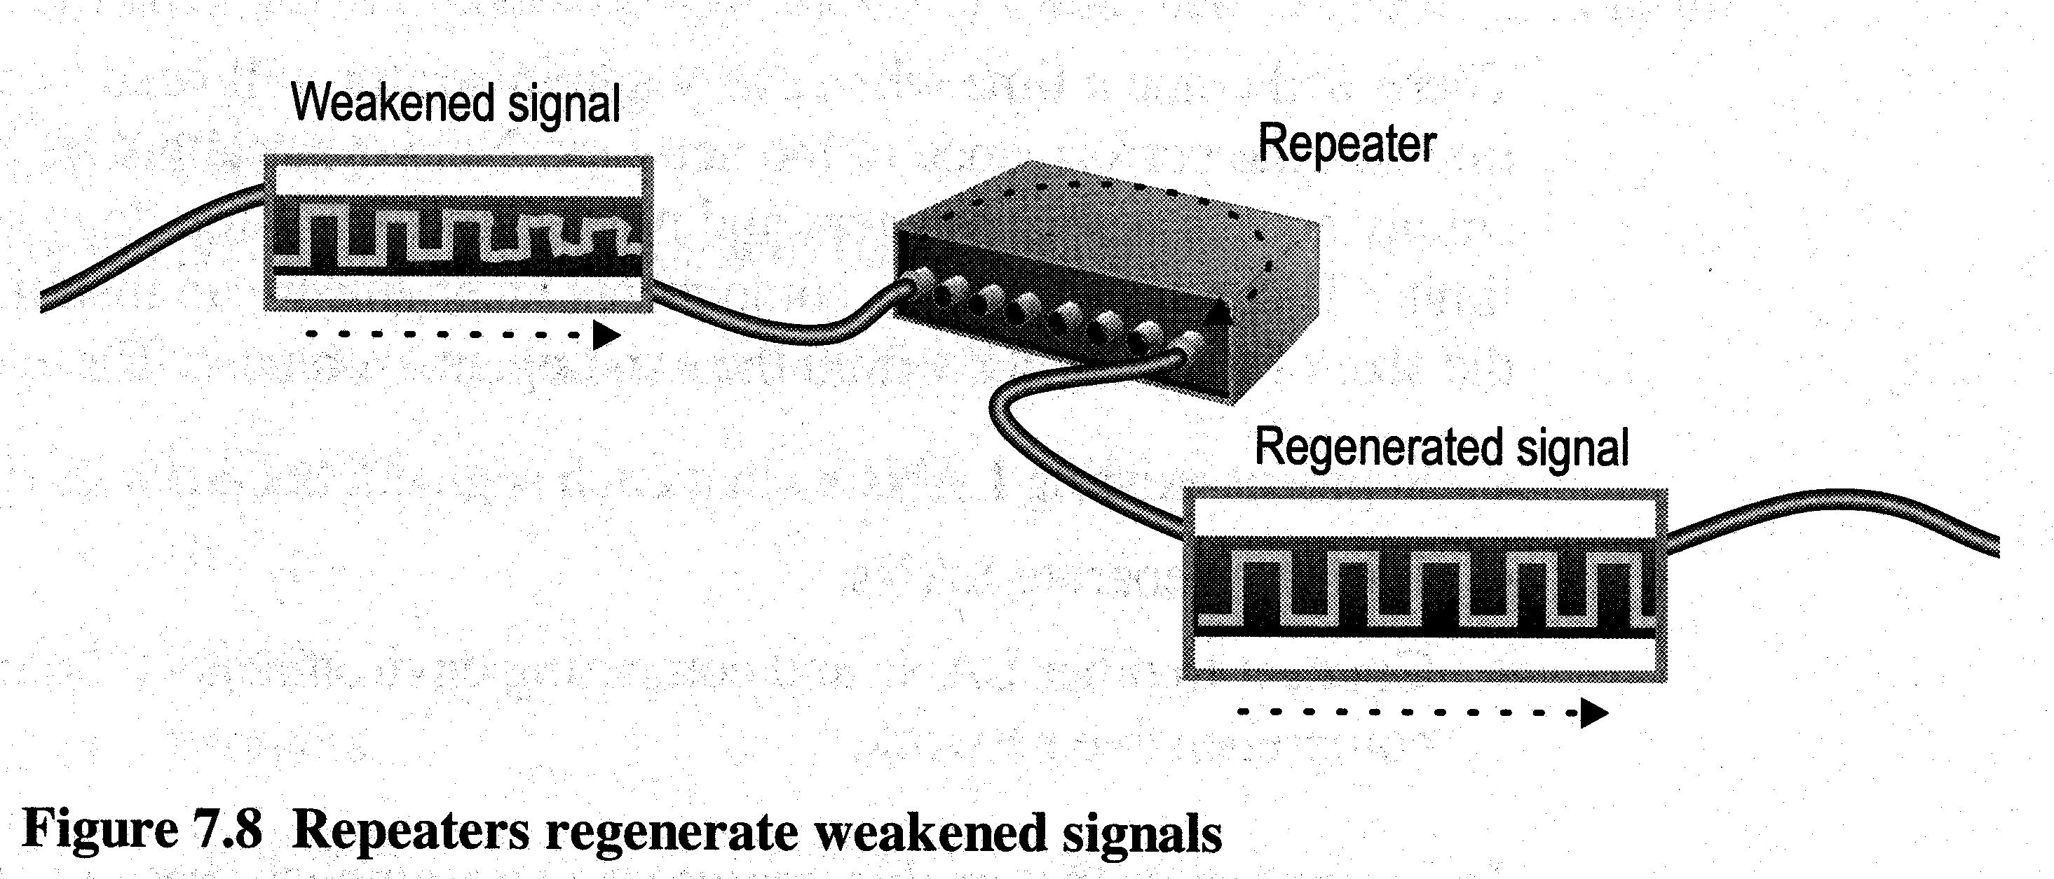
Active Hub
A multi port repeater
Normally used to create connections between stations in a physical star topology
Hubs can also be used to create multiple levels of hierarchy
The hierarchical use of hubs removes the length limitation of 10Base-T (100 m)
A hub takes the data that comes into a port and sends it out all the other ports in the hub. It doesn't perform any filtering or redirection of data.

Slide 29
HUB
A Hub is the simplest of these devices out of the five compared.
Hubs cannot filter data so data packets are sent to all connected devices/computers.
The device has to make decision if it needs the packet. This can slow down the network overall.
Hubs do not have intelligence to find out best path for data packets.
This leads to inefficiencies and wastage.
Pretty much repeat signal on one end to another.
Hubs are used on small networks where data transmission is not very high.

Slide 30
Bridge
A bridge is more complex than hub.
A bridge maintains a MAC address table for both LAN segments it is connected to.
Bridge has a single incoming and outgoing port.
Bridge filters traffic on the LAN by looking at the MAC address.
Bridge looks at the destination of the packet before forwarding unlike a hub.
It restricts transmission on other LAN segment if destination is not found.
Bridges are used to separate parts of a network that do not need to communicate regularly, but need to be connected.

Slide 31
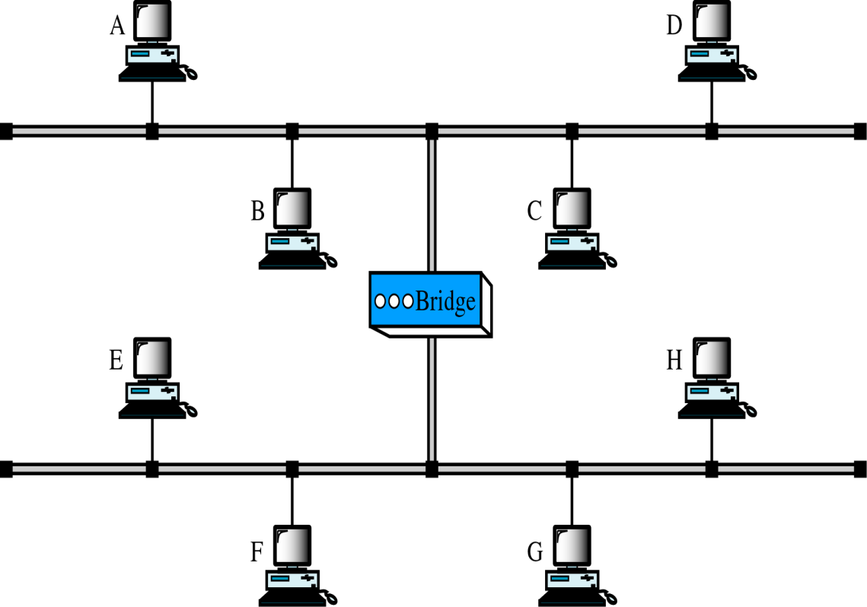
A bridge

Slide 32
Switch
A switch when compared to bridge has multiple ports.
Switches can perform error checking before forwarding data.
Switches are very efficient by not forwarding packets that error-ed out or forwarding good packets selectively to correct devices only.
Switches can support both layer 2 (based on MAC Address) and layer 3 (Based on IP address) depending on the type of switch.
Usually large networks use switches instead of hubs to connect computers within the same subnet.

Slide 33
Router
A router, like a switch forwards packets based on address.
A router uses the IP address to forward packets. This allows the network to go across different protocols.
Routers forward packets based on software while a switch (Layer 3 for example) forwards using hardware called ASIC (Application Specific Integrated Circuits)
Routers support different WAN technologies but switches do not.
Wireless Routers have Access Point built in.
The most common home use for routers is to share a broadband internet connection. The router has a public IP address and that address is shared with the network. When data comes through the router it is forwarded to the correct computer.

Slide 34
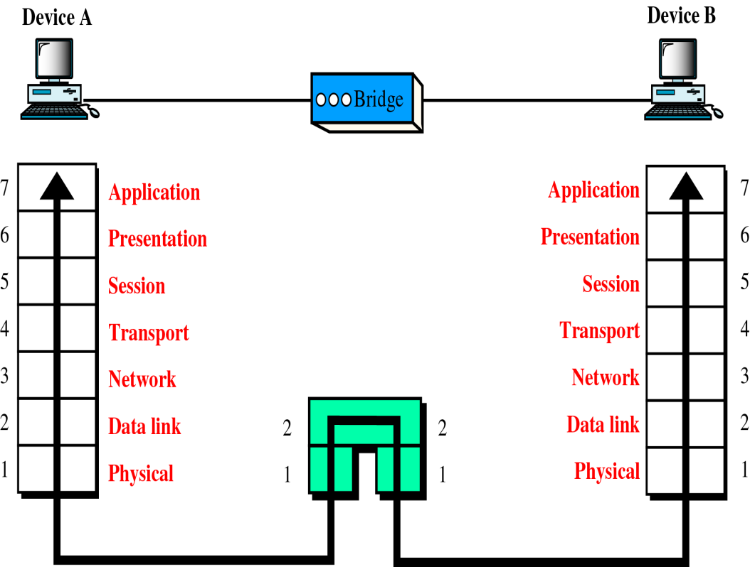
A bridge in the OSI model

Slide 35
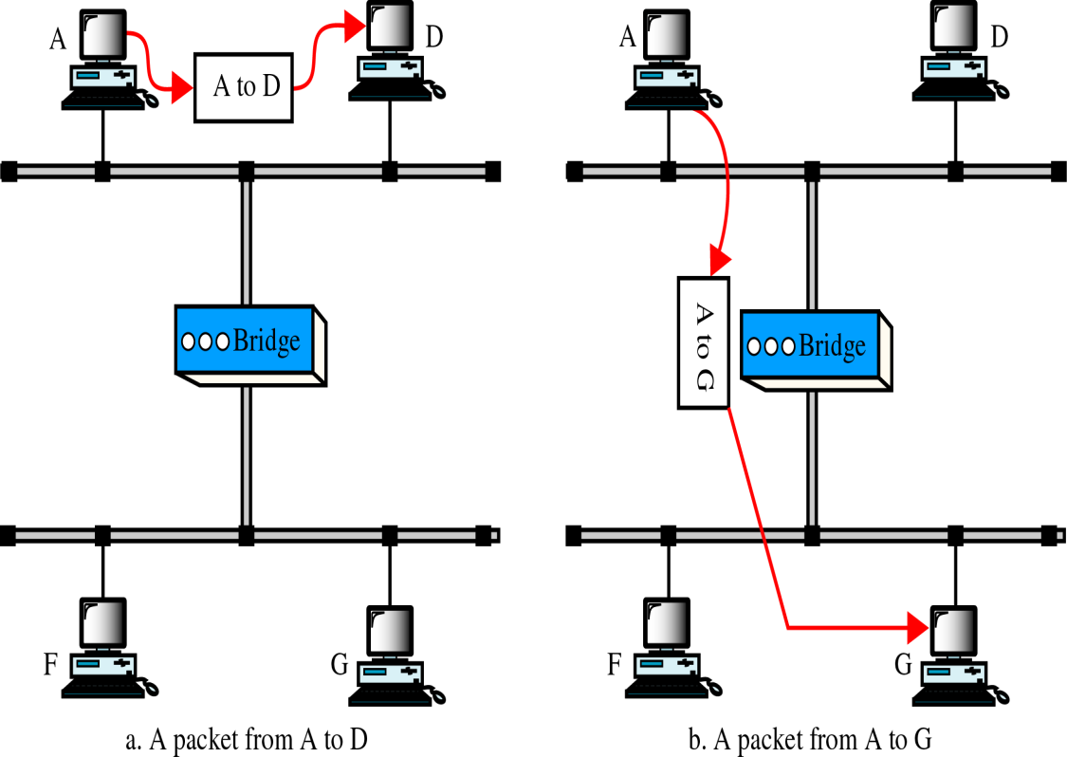
Function of a bridge

Slide 36
Bridge
Operates in both physical and data link layer
As a physical layer device, it regenerates the signal it receives.
As a data link layer device, the bridge can check the physical (MAC) addresses (source and destination) contained in the frame.
What is the difference between bridge and repeater??
It had the filtering capability.
It can check the destination address of a frame and decide if the frame should be forwarded or dropped. If the frame is to be forwarded, the decision must specify the port. A bridge has a table that maps addresses to ports.

Slide 37
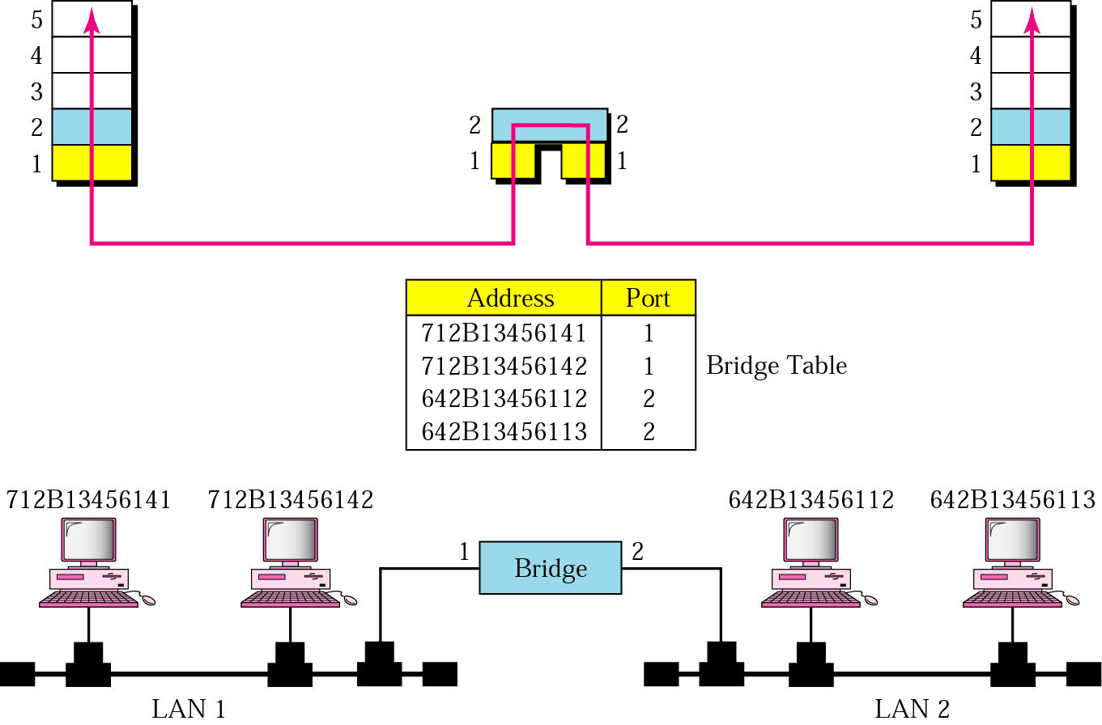
Bridge-example

Slide 38
Bridge- example
Two LANs are connected by a bridge.
If a frame destined for station 712B13456142arrives at port 1, the bridge consults its table to find the departing port. According to its table, frames for 7l2B13456142 leave through port 1; therefore, there is no need for forwarding, and the frame is dropped.
On the other hand, if a frame for 712B13456141 arrives at port 2, the departing port is port 1and the frame is forwarded.
Shown two port bridge, but in reality it has many ports.
Bridge doesn’t change the physical address (MAC) contained in the frame.

Slide 39
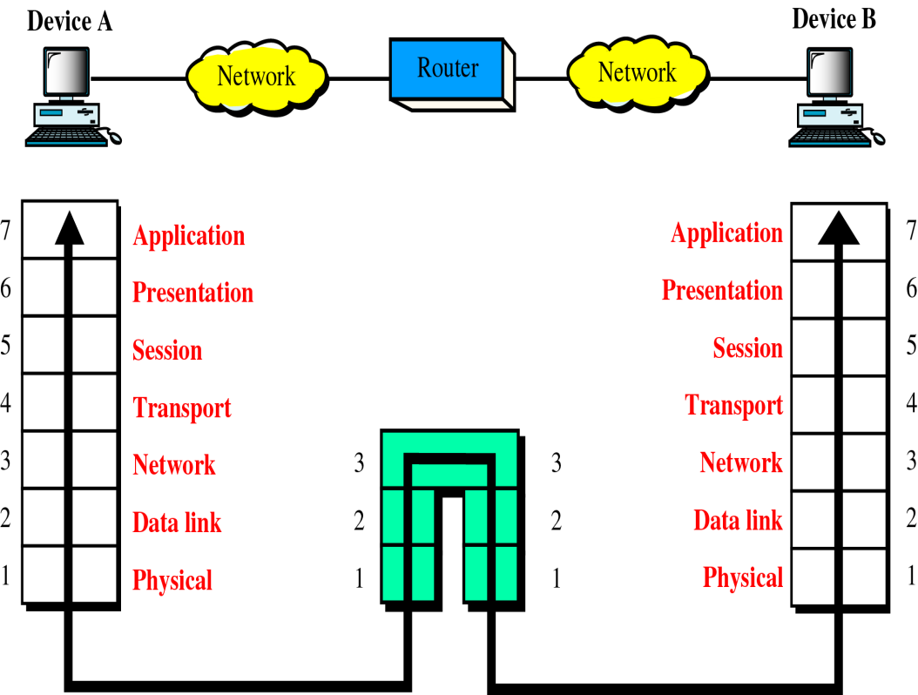
A router in the OSI model

Slide 40
A router
Device that operates in first three layers in the OSI model.
A router is a three-layer device that routes packets based on their logical addresses(host-to-host addressing).
A router normally connects LANs and WANs in the Internet and has a routing table that is used for making decisions about the route.
The routing tables are normally dynamic and are updated using routing protocols.

